Slide 1
Chapter 1: Operating System Overview

Slide 2
Computer Software can roughly be divided into two types:
Application Software: Which perform the actual work the user wants.
System Software: Which manage the operation of the computer itself
The most fundamental system program is the operating system, whose job is to control all the computer's resources and provide a base upon which the application program can be written. Operating system acts as an intermediary between a user of a computer and the computer hardware.

Slide 3
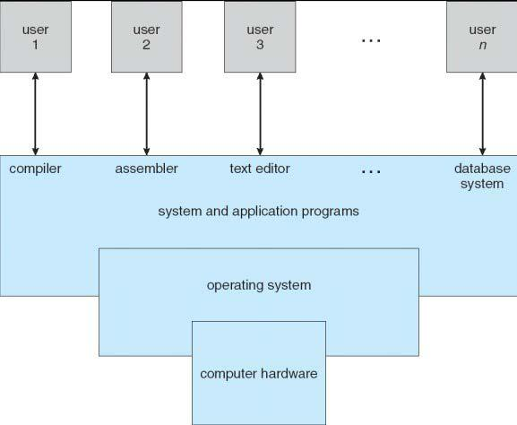
Abstract view of the components of a Computer System.

Slide 4
A computer system can be divided roughly into four components: the hardware, the operating system, the application program, and the users as shown in the fig above.
An operating system is similar to a government. Like a government it performs no useful function by itself. It simply provides an environment within which other programs can do useful work.

Slide 5
Hence, an operating system is a program that controls the execution of application programs and acts as an interface between the user of a computer and the computer hardware .
In other words, “The software that controls the hardware.” Some examples of operating systems are UNIX, Mach, MS-DOS, MS-Windows, Windows/NT, OS/2, MacOS, VMS, MVS, and VM.

Slide 6
Two views of the Operating System:
Operating System as an Extended Machine or Virtual Machine (or As a User/computer interface)
The operating system masks or hides the details of the Hardware form the programmers and general users and provides a convenient interface for using the system.
In this view the function of OS is to present the user with the equivalent of an extended machine or virtual machine that is easier to program than underlying hardware. Just as the operating system shields the user from the disk hardware and presents a simple file oriented interface, it also conceals a lot of unpleasant business concerning interrupts, timers, memory management and other low level features.
The placement of OS is as shown in fig

Slide 7
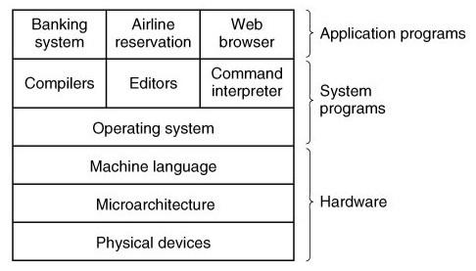
Fig: Computer system consists of Hardware, system program and application program
A major function of OS is to hide all the complexity presented by the underlying hardware and gives the programmer a more convenient set of instructions to work with

Slide 8
Operating System as a Resource Manager
A computer system has many resources. Modern computers consist of processors, memories, timers, disks, mice, network interfaces, printers, and a wide variety of other devices. In the alternative view, the job of the operating system is to provide for an orderly and controlled allocation of the processors, memories, and I/O devices among the various programs competing for them.
Figure below suggests the main resources that are managed by the OS. A portion of the OS is in main memory. This includes Kernel or nucleus. The remainder of main memory contains user programs and data. The allocation of this resource (main memory) is controlled jointly by the OS and memory management hardware in the processor

Slide 9
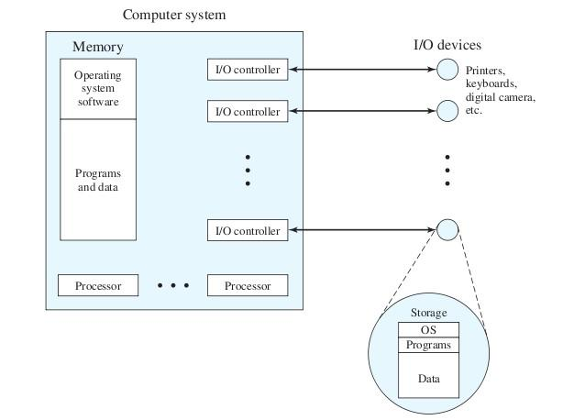
The Operating system as Resource manger

Slide 10
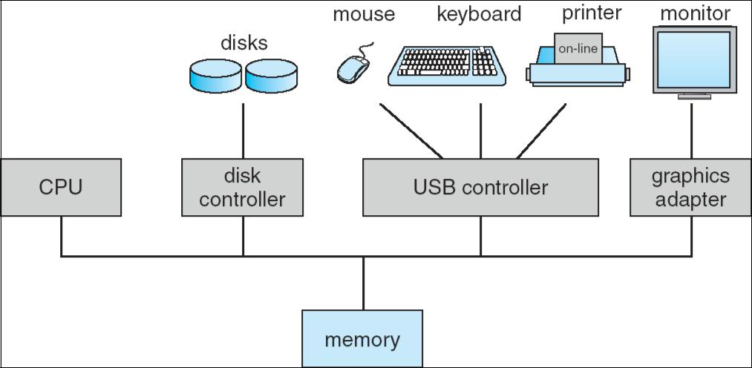
Computer System organization:
A modern general purpose computer system consists of one or more CPUs and a number of device controllers connected through a common bus that provides access to shared memory

Slide 11
Function of Operating system:
Implementing the user interface
Sharing hardware among users
Allowing users to share data among themselves
Preventing users from interfering with one another
Scheduling resources among users
Facilitating input/output
Recovering from errors
Accounting for resource usage
Facilitating parallel operations
Organizing data for secure and rapid access
Handling network communications.

Slide 12
These above functions can be summarized as,
Memory management function
Processors management function
I/O Device management function
File management function

Slide 13
Objectives
Convenience: An operating system makes a computer more convenient to use.
Efficiency: An operating system allows the computer system resources to be used in an efficient manner.
Ability to evolve: An operating system should permit the effective development, testing, and introduction of new system function without interfering with the service.

Slide 14
Services of operating system
Program creation: Operating system provides a variety of facilities and services, such as editors and debuggers, to assist the programmer in creating programs.
Program execution: A number of tasks need be performed to execute a program. The instructions and data must be loaded into main memory, I/O devices and files must be initialized, and other resources must be performed. The operating system handles all the tasks.
Access to I / O devices: Each I / O requires its own peculiar set of instructions, or control signals for operation. The operating system takes care of the details.
Controlled access to files: The operating system deals with the file format of the storage medium and the nature of I / O device.

Slide 15
System Access: The operating system controls the access to the system as a whole and to specific system resources. The access function must provide protection of resources and data from unauthorized users and must resolve conflict.
Error detection and response: The operating system must take the response that clears the error condition with the least impact on running applications.
Accounting: An operating system collects usage statistics for various resources and monitors performance parameters such as response time to improve performance.

Slide 16
Evolution of Operating System:
Serial processing
Batch processing
Multiprogramming
Multitasking or time sharing System
Network Operating system
Distributed Operating system
Multiprocessor Operating System
Real Time Operating System
Modern Operating system

Slide 17
Serial Processing:
Early computer from late 1940 to the mid 1950
The programmer interacted directly with the computer hardware.
These machines are called bare machine as they don't have OS.
Every computer system is programmed in its machine language.
Uses Punch Card, paper tapes and language translator
These systems presented two major problems.
Scheduling
Set up time

Slide 18
Scheduling:
Used sign up sheet to reserve machine time. A user may sign up for an hour but finishes his job in 45 minutes. This would result in wasted computer idle time, also the user might run into the problem not finish his job in allotted time.
Set up time:
A single program involves Loading compiler and source program in memory.
Saving the compiled program (object code)
Loading and linking together object program and common function

Slide 19
Each of these steps involves the mounting or dismounting tapes on setting up punch cards. If an error occur user had to go the beginning of the set up sequence. Thus, a considerable amount of time is spent in setting up the program to run. This mode of operation is turned as serial processing, reflecting the fact that users access the computer in series.

Slide 20
2.Simple Batch Processing:
Early computers were very expensive, and therefore it was important to maximize processor utilization.
The wasted time due to scheduling and setup time in Serial Processing was unacceptable.
To improve utilization, the concept of a batch operating system was developed.
Batch is defined as a group of jobs with similar needs. The operating system allows users to form batches. Computer executes each batch sequentially, processing all jobs of a batch considering them as a single process called batch processing.
The central idea behind the simple batch-processing scheme is the use of a piece of software known as the monitor.

Slide 21
With this type of OS, the user no longer has direct access to the processor. Instead, the user submits the job on cards or tape to a computer operator, who batches the jobs together sequentially and places the entire batch on an input device, for use by the monitor.
Each program is constructed to branch back to the monitor when it completes processing, at which point the monitor automatically begins loading the next program.

Slide 22
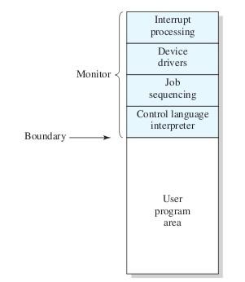

Slide 23
With a batch operating system, processor time alternates between execution of user programs and execution of the monitor. There have been two sacrifices: Some main memory is now given over to the monitor and some processor time is consumed by the monitor. Both of these are forms of overhead.

Slide 24
3.Multiprogrammed Batch System
A single program cannot keep either CPU or I/O devices busy at all times.
Multiprogramming increases CPU utilization by organizing jobs in such a manner that CPU has always one job to execute.
If computer is required to run several programs at the same time, the processor could be kept busy for the most of the time by switching its attention from one program to the next.
Additionally I/O transfer could overlap the processor activity i.e, while one program is waiting for an I/O transfer; another program can use the processor.
So CPU never sits idle or if comes in idle state then after a very small time it is again busy.

Slide 25
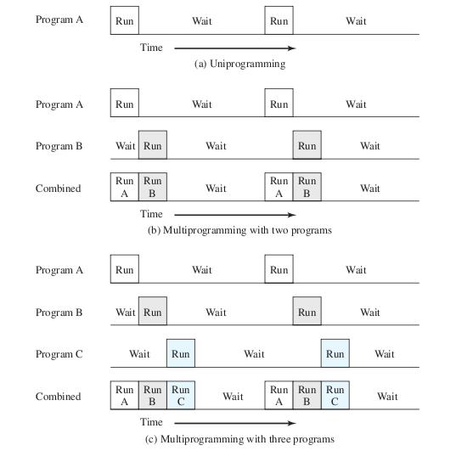

Slide 26
4.Multitasking or Time Sharing System
Multiprogramming didn't provide the user interaction with the computer system.
Time sharing or Multitasking is a logical extension of Multiprogramming that provides user interaction.
There are more than one user interacting the system at the same time
The switching of CPU between two users is so fast that it gives the impression to user that he is only working on the system but actually it is shared among different users.
CPU bound is divided into different time slots depending upon the number of users using the system.

Slide 27
Just as multiprogramming allows the processor to handle multiple batch jobs at a time, multiprogramming can also be used to handle multiple interactive jobs. In this latter case, the technique is referred to as time sharing, because processor time is shared among multiple users
A multitasking system uses CPU scheduling and multiprogramming to provide each user with a small portion of a time shared computer. Each user has at least one separate program in memory.
Multitasking are more complex than multiprogramming and must provide a mechanism for jobs synchronization and communication and it may ensure that system does not go in deadlock.

